Slide 1
Artificial Intelligence (AI-2002)
Lecture 11: Constraint Propagation: Inference in CSPs
Mr. Saif ur Rehman (Lecturer – AI & DS)
saifurrehman@nu.edu.pk

Slide 2

What is a Constraint Satisfaction Problem (CSP)?
How is a Constraint Satisfaction Problem defined?
What is the solution to a Constraint Satisfaction Problem?

Slide 3
Unary Constraint: A constraint that involves a single variable.
X ≠ 5 (where X is restricted from taking the value 5).
Binary Constraint: A constraint that involves two variables and defines a relationship between them.
Example: X>Y (where the value of X must be greater than Y).
Tertiary Constraint: A constraint that involves three variables and defines a relationship among them.
Example: X+Y=Z (where the sum of X and Y must be equal to Z).

Slide 4
Constraint Propagation: Inference in CSPs
An atomic state-space search algorithm makes progress in only one way: by expanding a node to visit the successors.
A CSP algorithm has choices.
It can generate successors by choosing a new variable assignment.
Or it can do a specific type of inference called constraint propagation

Slide 5
Constraint Propagation: Inference in CSPs
Constraint Propagation: Reduces the number of legal values for a variable by using constraints, which can further restrict values for other variables.
Effect on Search: Fewer choices remain for variable assignments, making the search process more efficient.
Integration with Search: Can be used alongside search or as a preprocessing step before search begins.
Complete Problem Solving: In some cases, constraint propagation alone can solve the entire problem without requiring a search.

Slide 6
Constraint Propagation: Inference in CSPs
Local Consistency: The core idea behind constraint propagation, ensuring that constraints hold in smaller parts of the problem space.
There are different types of local consistency, which we now cover in turn.

Slide 7
Node consistency
A single variable (corresponding to a node in the CSP graph) is node-consistent if all the values in the variable’s domain satisfy the variable’s unary constraints.

Slide 8
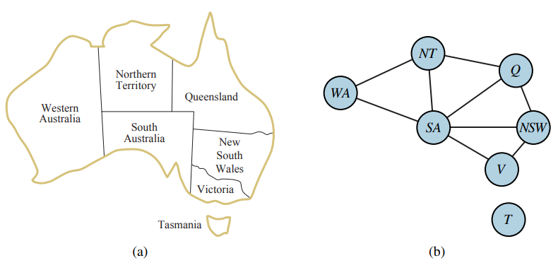
Node consistency
A graph is node-consistent if every variable in the graph is node-consistent.
South Australians dislike green.
the variable SA starts with domain {red,green,blue}
How to make the SA node consistent?

Slide 9
Arc consistency
A variable in a CSP is arc-consistent if every value in its domain satisfies the variable’s binary constraints.
More formally, Xi is arc-consistent with respect to another variable Xj if for every value in the current domain Di there is some value in the domain Dj that satisfies the binary constraint on the arc (Xi ,Xj).
A graph is arc-consistent if every variable is arc consistent with every other variable.

Slide 10
Arc consistency
Consider the constraint Y = X^2.
Domain of both X and Y is the set of decimal digits.
We can write this constraint explicitly as
How to make X arc-consistent with respect to Y?
How to make Y arc-consistent with respect to X?

Slide 11
Arc consistency
How to make X arc-consistent with respect to Y?
We reduce X’s domain to {0,1,2,3}.
How to make Y arc-consistent with respect to X?
Y’s domain becomes {0,1,4,9}.

Slide 12
Arc consistency
Arc consistency can do nothing for the Australia map-coloring problem.
Why?
Consider the following inequality constraint on (SA,WA):
SA | WA
Red | Red
Blue | Blue
Green | Green

Slide 13
What does it mean for an arc to be consistent?

Slide 14
What does it mean for an arc to be consistent?
An arc <X, r(X, Y)> is arc consistent if for each value x in dom(X) there is some value y in dom(y) such that r(x, y) is satisfied.

Slide 15
How can we enforce consistency of an arc <X,r(X,Y)>?

Slide 16
How can we enforce consistency of an arc <X,r(X,Y)>?
Remove all the values x in dom(x) for which there is no corresponding value y in dom(y) that satisfies the constraint.

Slide 17
What does it mean for a network to be arc consistent?

Slide 18
What does it mean for a network to be arc consistent?
All of its arcs are consistent.

Slide 19
What are the possible outcomes of the arc consistency algorithm?

Slide 20
What are the possible outcomes of the arc consistency algorithm?
At least one domain could be empty, in which case there is no solution. Each domain could have a single value, in which case there is a unique solution. Or some domains could have multiple values.

